Slide 1
High Valued Customer Analysis
IPBA BATCH-09 Group-d
Amit Sharma
Anand Tiwari
Haripriya Dittakavi
Nikhil Kalsi
Nishant Sharma
Purvanshu Singhal
Saraj Sadanand
Urvashi Jain

Slide 2
CAPSTONE PROJECT DOMAIN : E-COMMERCE
Objectives of BYOP
Identify High Value Customers to improve Sales and Customer Retention
Problem Statement
To understand the customer lifetime value prediction by using RFM technique and other ML methods using customer purchase data.
Kaggle Dataset

Slide 3

Project Data Description :
Master Data Set:
Item wise orders : 576k records
Time Period : 2 years
Column Distribution :
21 Features for each Item Id in Order
Major Dimensions :
Products - Product-Category, Sku, Discount Amt
Orders - Order Status, Order Date, Order Amt
Customers – Customer Id, Customer Since

Slide 4
Project Approach
Data Acquisition
Ingest Raw Data
Problem Framing
Exploratory Data Analysis : Data Transformation
Data Evaluation for meaningful insights
Process Features : Order Status, Payment Methods, Product Category
Recommendations
Final Suggestions
Business Understanding
Time Series Analysis
Graphical Representation
Clustering & Binning
Customer Order Data
Showcase Insights
Other ML Methods
Model Building
Timeframe for Customer Lifetime
RFM Based Modelling
CLTV Prediction
Evaluate Performance
Model Selection & Finalization
Data Preparation : Data Cleaning
Missing Value Treatment
Feature Selection
Redefined Categorization (Order Status, Product Category)
Defining Data Types
Imputation of Incorrect Values (ex: Discount)

Slide 5

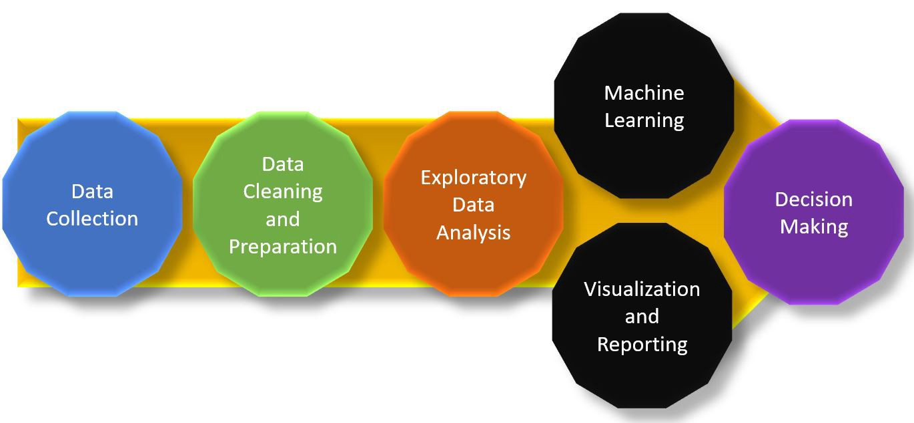

Slide 6
EDA process using Python
Refining the given data set to understand insights through key characteristics of various entities of the data source like column(s), row(s) by applying Pandas, NumPy, Statistical Methods, and Data visualization packages.
Feature creation
Missing Value Treatment
Renaming column Identifiers
Variable Transformation
Bi-Variate Analysis
Dropping Missing or null Values
Dropping Irrelevant Columns
Allocating appropriate data types for columns
Detecting Outliers
Imputation of Values for Outliers

Slide 7
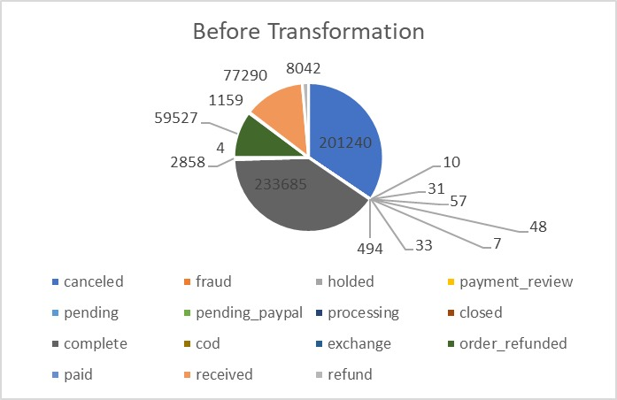
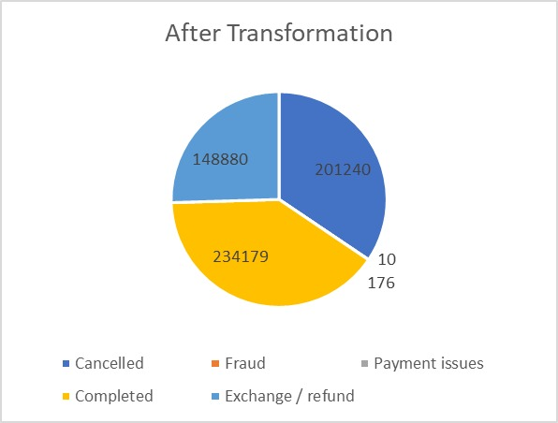
Order Distribution : Redefined Categories
60% of total orders were getting cancelled or refunded.

Slide 8
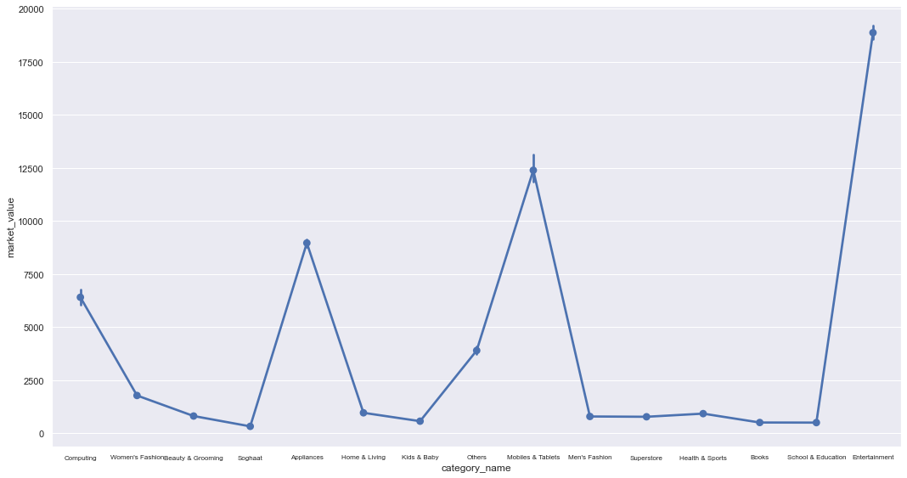
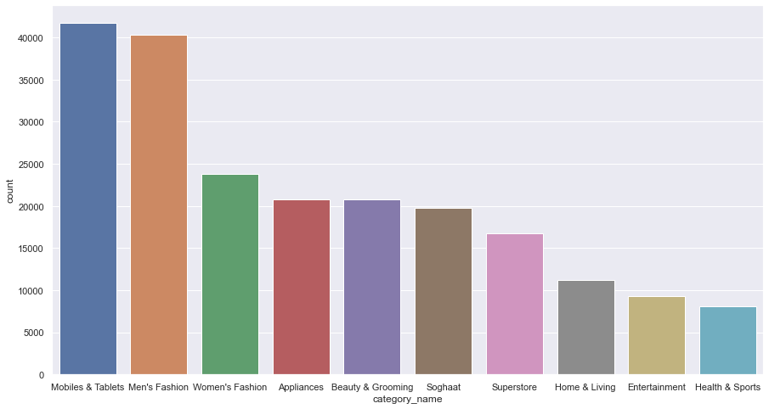
Completed Orders EDA – Product Category Electronic Products contribute to the highest number of orders while Market Value wise Entertainment product sales are leading.
Entertainment, Mobiles & Tablets, Appliances and Computing product categories lead high value sales.
Electronics and fashion items contributes to nearly 50 % of total orders
Market Value for Each Product Category
Product Category Count

Slide 9
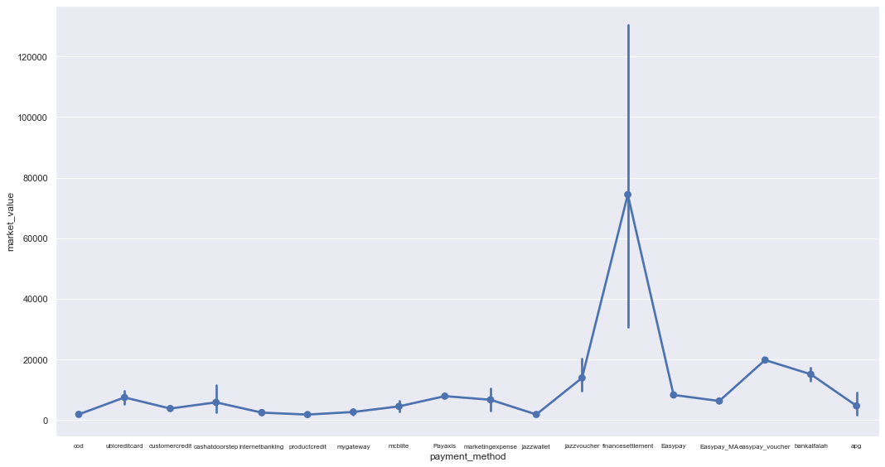
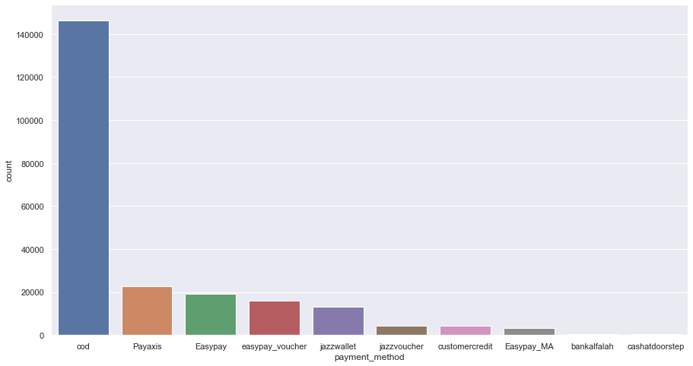
Completed Orders EDA – Payment Method COD is the most popular payment method while High Valued Sales were observed for Easy Pay/Jazz Vouchers
9 orders contributed to finance settlement / business transactions
COD amounts t0 ~65% of Completed Orders
Market Value For Each Payment Method
Payment Method Count

Slide 10
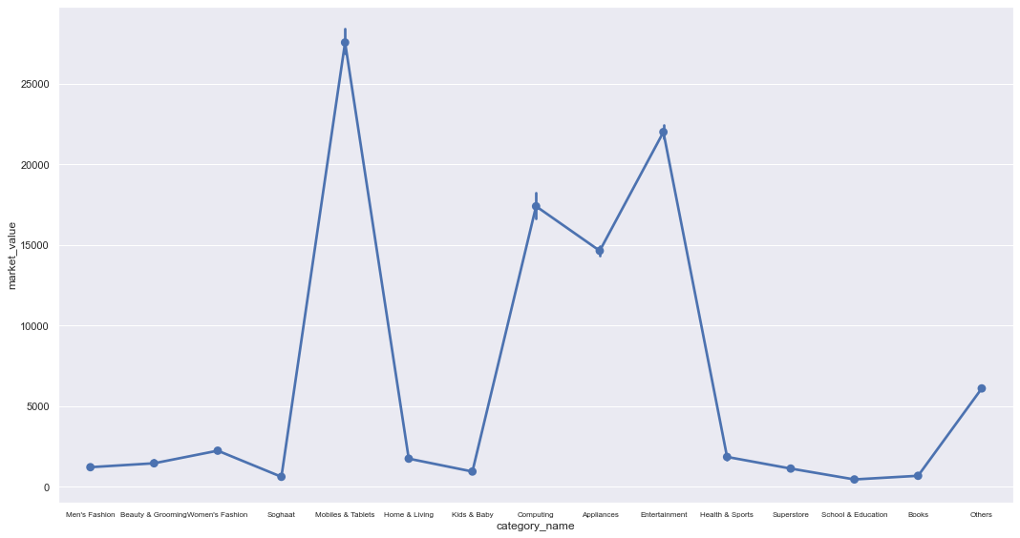
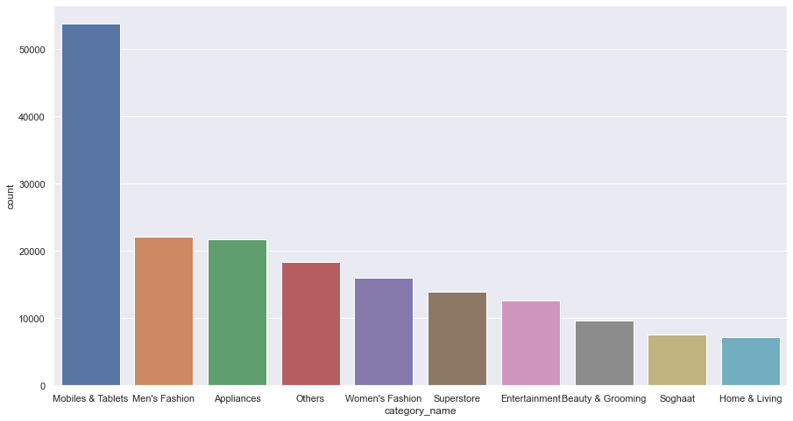
Cancelled Orders EDA – Product Category Electronic Products drive more than 60% of total value
Mobiles and tablets, Men Fashion and Appliances top the cancelled orders as per Category count
Electronic products show max cancellation as per Market Value
Market Value for Each Product Category
Product Category Count

Slide 11
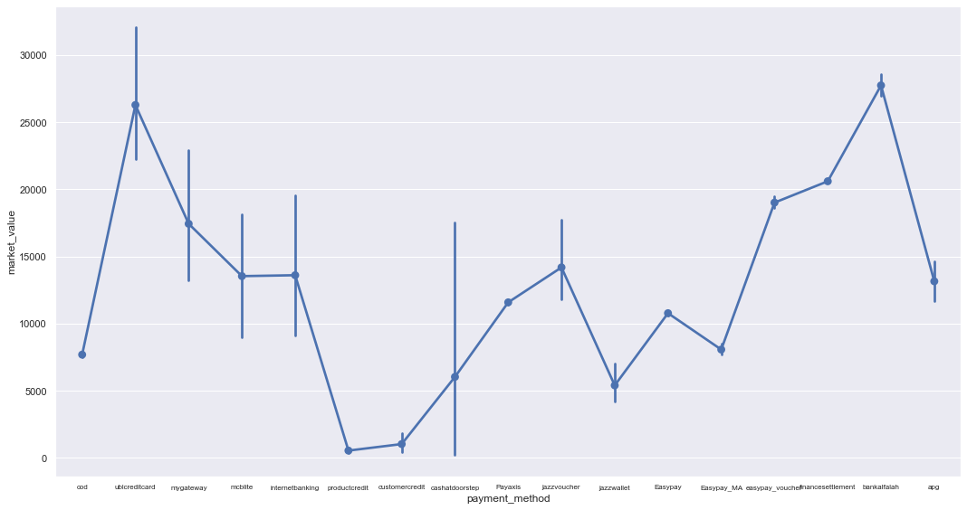
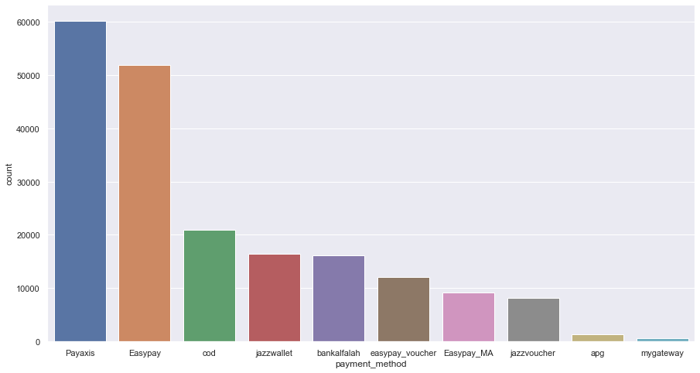
Cancelled Orders EDA – Payment Method
Easy Pay and Pay Axis contributing to the highest cancelled order.
Payment ubi credit card and Bank Alfalah have the highest market value cancelled order (> 25000).
Market Value For Each Payment Method
Payment Method Count

Slide 12
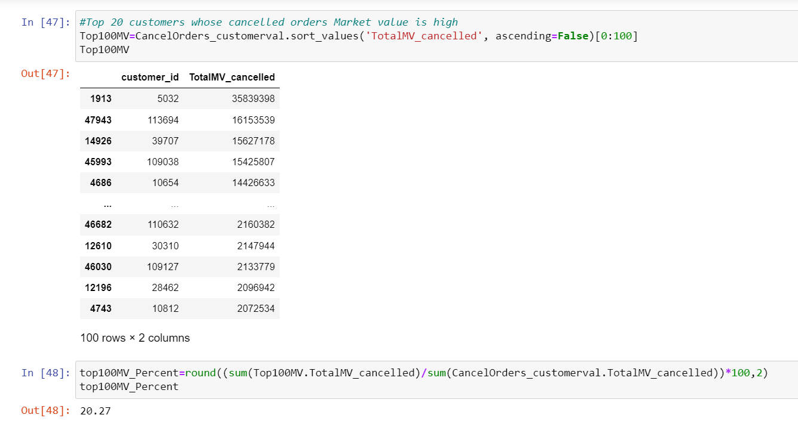
Cancelled Orders EDA : Top Contributors 20% of total cancelled order value is contributed by 100 customers. Business can focus on understanding the needs of these customers and convert them to business realized.

Slide 13
Identification Of High Value Customers
Approach 1 : RFM SCORING

Slide 14
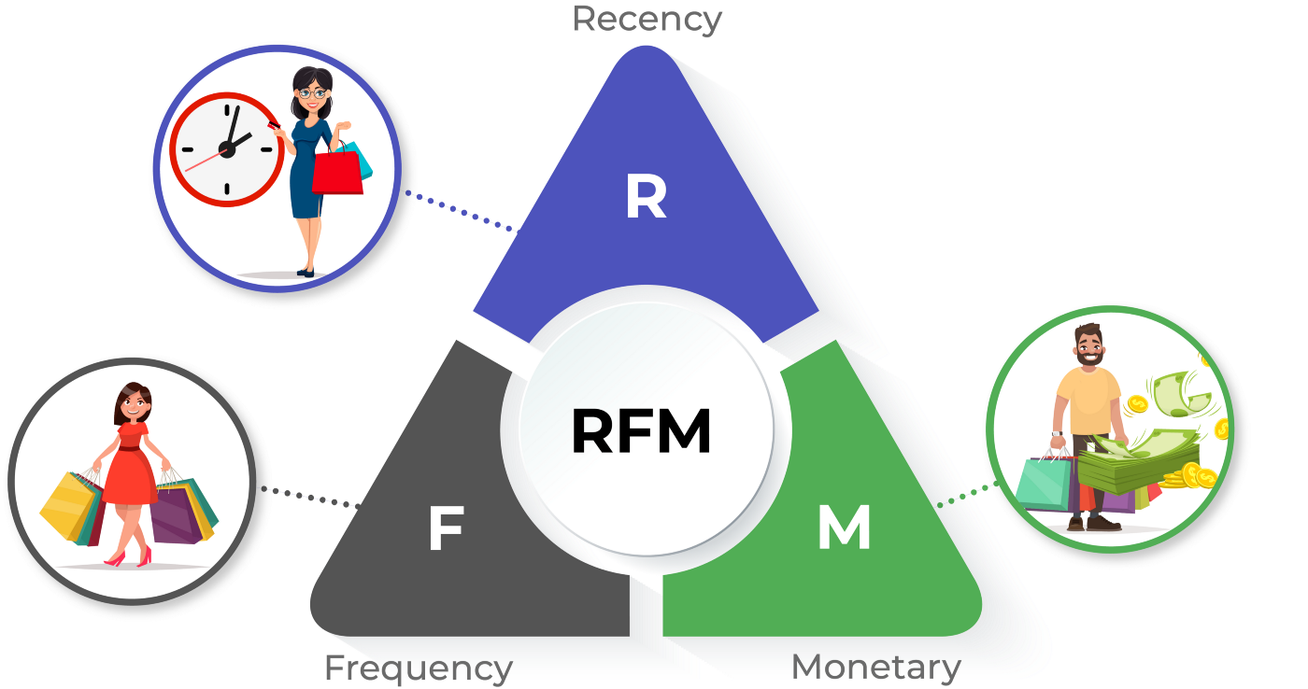
RFM MODEL
The RFM model is a behavioral segmentation method that allows you to segment and analyze customers based on three variables in your historical data:
Recency (R), Frequency (F), and Monetary value (M).
Recency : How recently the customers have made a purchase.
Frequency : How frequently they make purchases
Monetary : How much a customer usually spends on the website

Slide 15
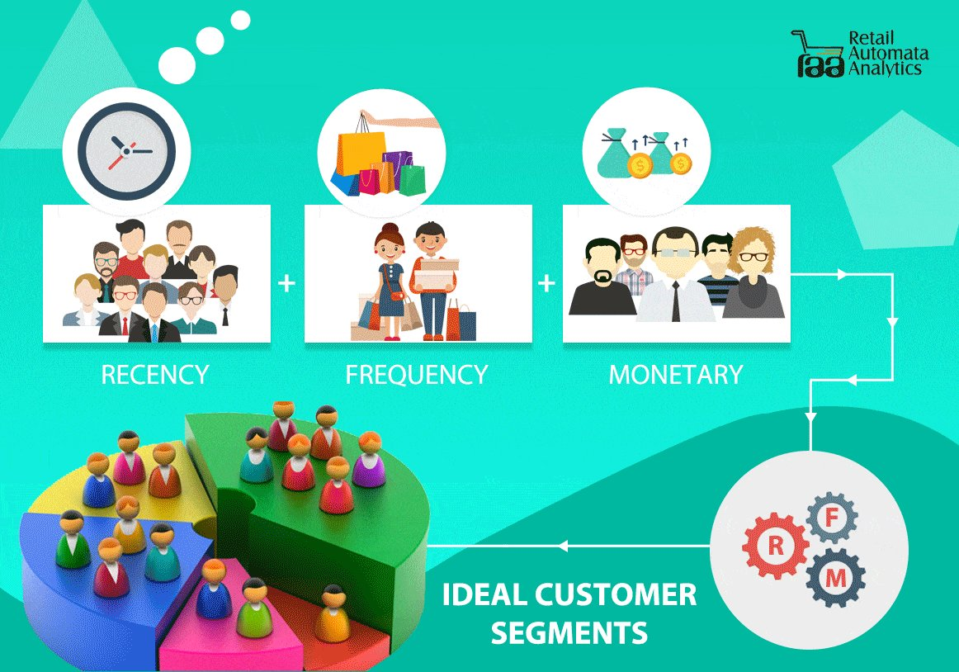
RFM ANALYSIS METHODOLOGY Allows Business to find answers to the following questions :
Who are the loyal customers?
Which customers must be retained?
Which customers have the potential to convert into regular profitable customers?
Who are those inconsistent customers who don’t engage regularly with the website?
Which group of customers is most probable to respond to your campaign?
Who are the churned out customers and who are about to churn?

Slide 16
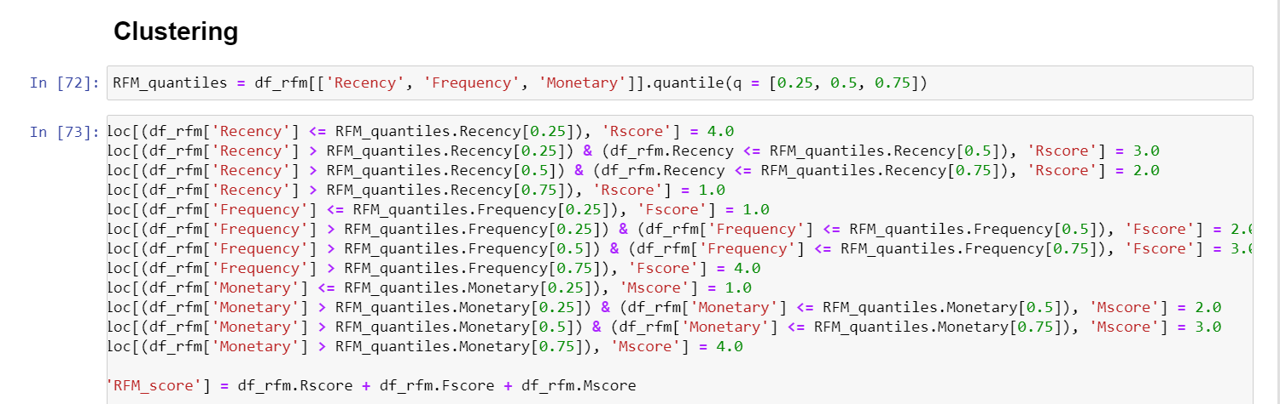
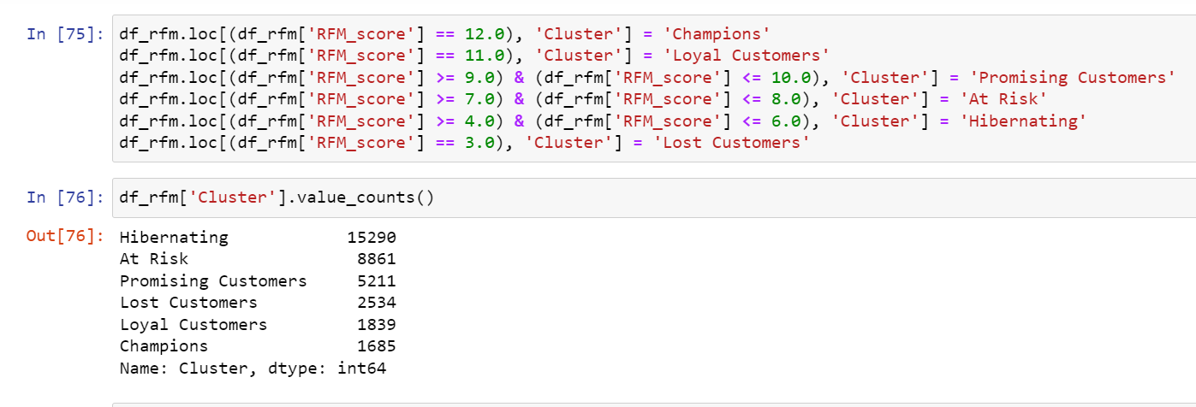
Customer Segmentation Based on RFM Scores

Slide 17
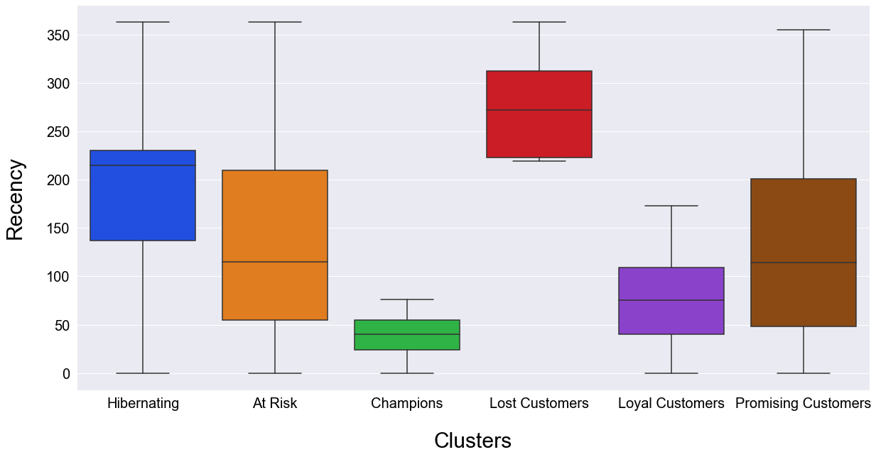
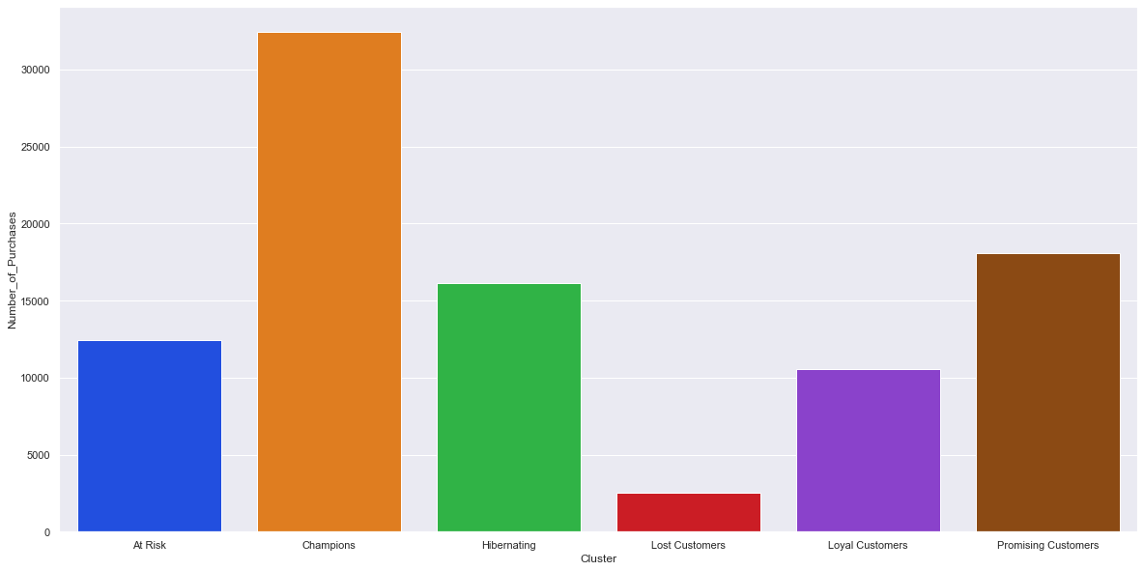
Clustering Insights
Champions & Loyal Customers contribute 46% of total order frequency
Promising and Hibernating Customers show High Variation.
Champions and Loyal Customers have the least variation in terms of Recency

Slide 18
Identification Of High Value Customers
Approach 2 :
Customer lifetime value (CLTV) prediction using ml models

Slide 19

Understanding and Forecasting Customer Lifetime Value (CLTV)
The average revenue that can be generated from customers over the entire lifetime of their account.
Provides customer-centric perspective to guide some critical marketing and sales strategies
CLTV indicates the overall health and the ability of the business to retain customers.

Slide 20
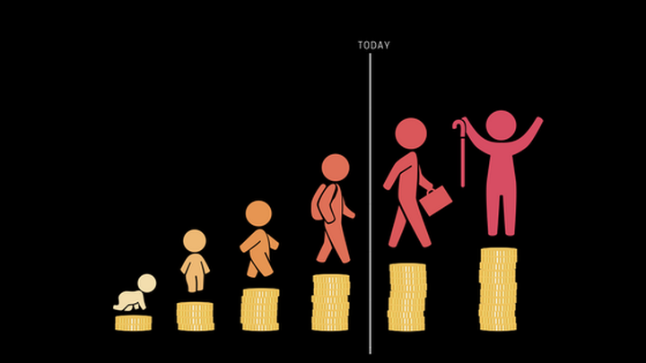
CLTV Calculation
Target variable - CLTV For each customer (one row for each Customer ID) :
Average Order Value = Total Sales / Order Count
Purchase Frequency = Total Orders / Total Customers
Customer Value = Average Order Value x Purchase Frequency
Customer life span = last transaction month - customer since month
CLTV = Customer Value x customer life span

Slide 21
ML Model : Approach Finalization
CLTV Continuous :
Generalized Liner Model (GLM)
Random Forest Regressor
Bagging Regressor
XG Boost Regressor
CLTV Categorical :
Random Forest Classifier
XG Boost Classifier (With Grid Search)

Slide 22
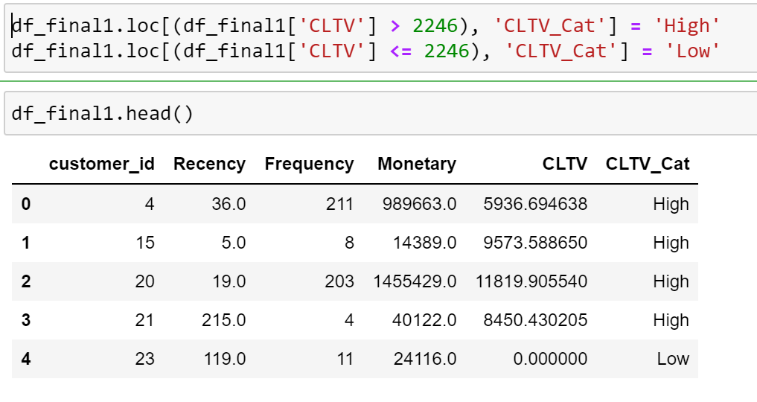
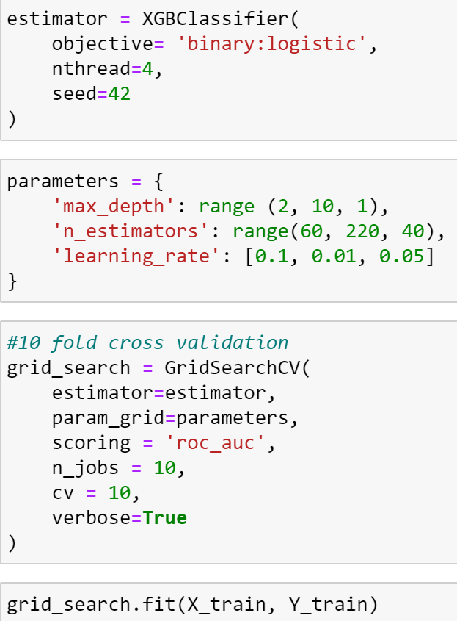
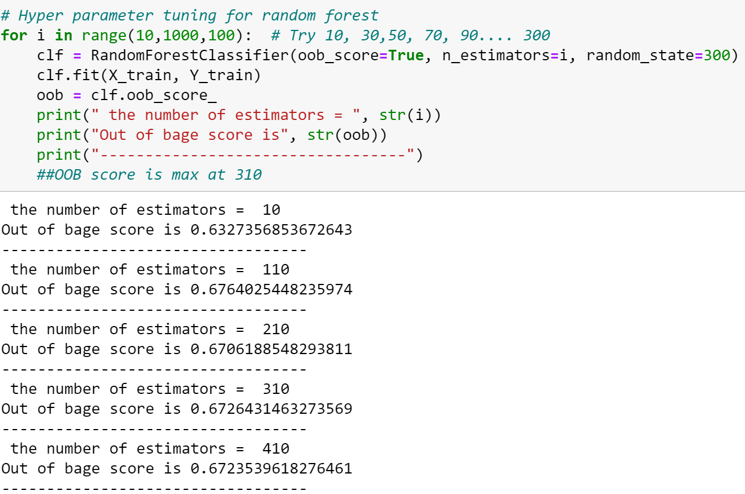
Random Forest and XG Boost Classifier
Method | Training Accuracy | Testing Accuracy
Random Forest Classifier | 0.99 | 0.67
XG Boost Classifier | 0.79 | 0.71
Considering the consistency of prediction in Testing Data set, XG Boost Classifier is suggested as final model

Slide 23
Recommendations for ML model improvements
Address imbalance in CLTV categories by using techniques like SMOTE
Collect more features data to improve predictability like customer location, age, salary and other demographic information
As major sales is in product categories like Computing, Appliances, Mobiles and Tablets, which usually have high lead time for new purchases, collect few more year data
Explore if Monetary value of customer for each product category improve CLTV prediction instead of total monetary value

Slide 24
Thankyou

